Slide 1

Practice Education 1
Introduction to Module
Ngozi Onuegbu PhD
PT5W50/PT4W50

Slide 2
Session Learning Outcomes
Explain
Explain the aims and objective of the module
Highlight
Highlight the learning approaches utilised in the module
Identify
Identify key learning resources to support the module
Demonstrate
Demonstrate understanding of the module assessments and timelines

Slide 3
Introductions:
Module Lead
Team
Students

Slide 4
Module Aims (What we want to do achieve)
Provide
Provide opportunities for you to:
Complete
Complete mandatory practice-based learning elements required to graduate with eligibility to register as a Physiotherapist.
Practice and consolidate
Practice and consolidate clinical and non-clinical skills learnt in first year academic modules under the supervision and guidance of clinical educators within healthcare environments
Embed
Embed professionalism, conduct, ethics and performance behaviours required for contemporary Physiotherapy practice
Develop
Develop transferable skills learnt in academic modules such as critical appraisal and evaluation; clinical-reasoning and problem-solving; self and caseload management; communication and teamwork.

Slide 5
Module learning Outcomes (what you will achieve)
At the end of the module, students should be able to:
Work safely and in a non-discriminatory manner within the parameters of local/national policies & protocols when in health and social care settings.
Demonstrate safe and effective professional practice within own scope of practice during placement including maintenance of own fitness to practice, professionalism, interpersonal skills, clinical reasoning, assessment, treatment/management, monitoring, evaluation, record keeping and quality assurance.
Communicate effectively and respectfully with service users, carers, clinical educators, and appropriate members of the multidisciplinary team, (using a wide range of appropriate communication skills including verbal, non-verbal, written and listening) to both share and receive information.

Slide 6
Module learning Outcomes (what you will achieve)
At the end of the module, students should be able to:
Apply key theoretical perspectives and evidence under-pinning effective physiotherapy assessment, clinical reasoning, and management.
Demonstrate initiative in the organisation, prioritisation of own workload and delegate tasks safely and appropriately.
Reflect on own practice skills, seek, and respond appropriately to feedback during practice placements for continuing professional development.

Slide 7
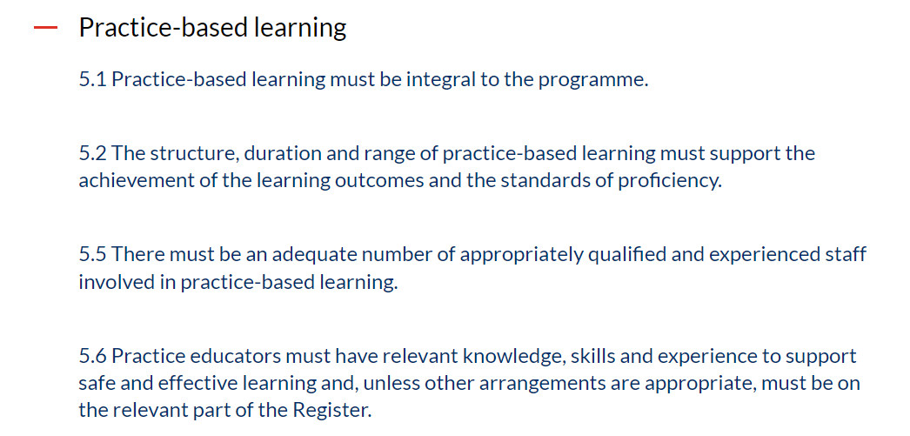
HCPC SOET & CSL Learning, and Development Principles related to Practice based learning
Notes:
HCPC expects practice-based learning to be integral to the programme
Must support the achievement of the standards of proficiency
Supported by staff who are qualified and experienced in practice-based learning, knowledgeable and skilled
The CSP extends this further by expecting that students should be provided a balanced sequence of practice placements which represents a diverse range of settings in contemporary practice
Progressive in terms of demands on competencies to prepare for autonomous practice
1000 clinical hours which may include clinical simulation

Slide 8
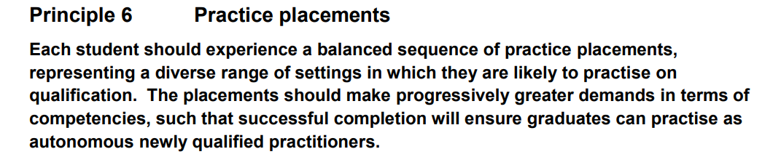
HCPC SOET & CSL Learning, and Development Principles related to Practice based learning
Notes:
HCPC expects practice-based learning to be integral to the programme
Must support the achievement of the standards of proficiency
Supported by staff who are qualified and experienced in practice-based learning, knowledgeable and skilled
The CSP extends this further by expecting that students should be provided a balanced sequence of practice placements which represents a diverse range of settings in contemporary practice
Progressive in terms of demands on competencies to prepare for autonomous practice
1000 clinical hours which may include clinical simulation

Slide 9
HCPC SOET & CSL Learning, and Development Principles related to Practice based learning
The consensus from the student body, academics, managers and educators is
1000 hours ➔ One Academic year worth of full-time study
Notes:
HCPC expects practice-based learning to be integral to the programme
Must support the achievement of the standards of proficiency
Supported by staff who are qualified and experienced in practice-based learning, knowledgeable and skilled
The CSP extends this further by expecting that students should be provided a balanced sequence of practice placements which represents a diverse range of settings in contemporary practice
Progressive in terms of demands on competencies to prepare for autonomous practice
1000 clinical hours which may include clinical simulation

Slide 10
Indicative Syllabus
Mandatory training: Safeguarding Children and Adults, Infection Control and Risk Assessment training, information governance, Digital professionalism
Cardiopulmonary Resuscitation (CPR) and Manual Handling (MH), Data safety Awareness,
Fitness to Practice, own scope of practice, relevant and appropriate sources of support, advice, and guidance and how to access them whilst on placement
Multi-professional practice including knowledge and understanding of common clinical problems, differences between impairment and disability, health and safety factors, recent research, and clinical developments.
Physiotherapy framework to map personal development

Slide 11
Core skills developed
Manual Handling, cardiopulmonary resuscitation
Appropriate clinical focussed and multi-disciplinary communication
Clinical Information interpretation, accurate record keeping in relevant patient documentation
Estimating impact of common problems on individual patients’ lifestyles and social functioning
Clinical management skills including assessment, problem identification, treatment/ interventions planning, setting SMART goals for management of disability and progressing them.
Effective delivery of safe clinical and appropriate handling skills
Self-awareness for maintaining personal health and well-being

Slide 12
Teaching Approach
Clinical Simulation
Reflective practice
Practice placements
Portfolio development

Slide 13
Placement dates for MSc 2024/25 Cohort
Dates for MSc 2024/25 academic year
Placement Number | Duration | Hours per week | Placement Level | Start | Finish
Placement 1 (One day a week in practice: Thursdays) | 5 weeks (inclusive of 1 week of clinical simulation) | 7 | Clinical Simulation | 26/09/2024 | 24/10/2024
 |  |  | 5 | 31/10/2024 | 03/04/2025
Placement 2 | 6 weeks | 37.5 | 5 | 21/07/2025 | 30/08/2025
Placement 3 | 6 weeks | 37.5 | 6 | TBA | TBA
Placement 4 | 6 weeks | 37.5 | 6 | TBA | TBA
Placement 5 (elective) | 6 weeks | 37.5 | 6 | TBA | TBA

Slide 14
Placement dates for BSc 2024/25 Cohort
Dates for Bsc 2024/25 academic year
Placement Number | Duration | Hours per week | Placement Level | Start | Finish
Placement 1 (One day a week in practice: Thursdays) | 5 weeks (inclusive of 1 week of clinical simulation) | 7 | Clinical Simulation | 26/09/2024 | 23/01/2025
 |  |  | 4 | 30/01/2025 | 03/04/2025

Slide 15
Placement 1 MSc
 | Type | When | Content | Level | Duration | Total Hours
Placement 1 | Clinical Simulation | Every Thursdays (10am – 5:00pm) | Group based learning Clinical debriefing Self-directed Learning of mandatory skills | 5 | 5 weeks | 35 hours
 | Longitudinal Placement | Every Thursday (7.5 hours) 31/10/2024 – 03/04/25 MSc (three weeks break over Christmas and New Year) | Clinical observation Clinical practice | 5 | 20 weeks | 150 hours
 | Total |  |  |  | 25 weeks | 185hours

Slide 16
Placement 1 BSc
 | Type | When | Content | Level | Duration | Total Hours
Placement 1 | Clinical Simulation | Every Thursdays (9 am – 5:00pm) | Group based learning Clinical debriefing Self-directed Learning of mandatory skills | 4 | 10 weeks | 70 hours
 | Longitudinal Placement | Every Thursday (7.5 hours) 31/10/2024 – 03/04/25 MSc 30/01/2025 - 03/04/25 BSc (three weeks break over Christmas and New Year) | Clinical observation Clinical practice | 4 | 10 weeks | 75 hours
 | Total |  |  |  | 25 weeks | 145hours

Slide 17
Clinical Simulation
Aims:
Introduce you to the clinical education aspect of the course and support development of core skills in preparation for placements.
5 weeks (MSc); 10 weeks (BSc) (Thursdays):
Group tasks, self directed learning, manual handling training, basic life support, mandatory learning for working in healthcare.
Learning Outcomes are detailed in the Module specifications on Weblearn

Slide 18
Longitudinal placement
See module specifications and placement handbooks on weblearn to identify the learning outcomes for level 4/5 placements
Will be allocated to a clinical service – you will receive an email from PMP about your allocation.
Allocation is based on a reasonable commute of 90 minutes from London Metropolitan University
You will have a Practice Educator (PE) who will supervise, guide and support your learning
PE will also be assessing your learning.

Slide 19
Before Allocation
Completion of DDS Questionnaire
Signing of Allocations policy
Update to HCPC Standards of Proficiency, Conduct and Ethics
Occupational Health processes

Slide 20

After Allocation
You must contact your PE using the details on your allocation
This MUST be done within TWO weeks of your first day on placement.
You will also be provided a LINK Tutor who will be an academic member of staff.
Details of your LINK tutor and the appropriate assessment form for your placement will be sent to you by the placement co-ordinator.

Slide 21

Before placement
A contact number and reporting arrangements.
Pre-placement reading (available on the PMP website)
General location information including maps, car parking, accommodation etc
Learning resource facilities including library, study areas, reference literature and computer access
The University’s process for raising concern on the safety and wellbeing of Children, Young People and Vulnerable Adults (Appendix 2).

Slide 22
On the first day of the placement, students will should be given a range of information including:
The name of a physiotherapist to contact in an emergency
Information about the communication system; bleeps, telephones etc.
Department information: changing facilities, staff room, lunch time, start and finish times etc
Departmental policies and procedures; Health and Safety and Manual Handling policies, bullying and harassment, complaint procedures etc.
General information about the site; banks, shops, canteens
Departmental staffing structure

Slide 23
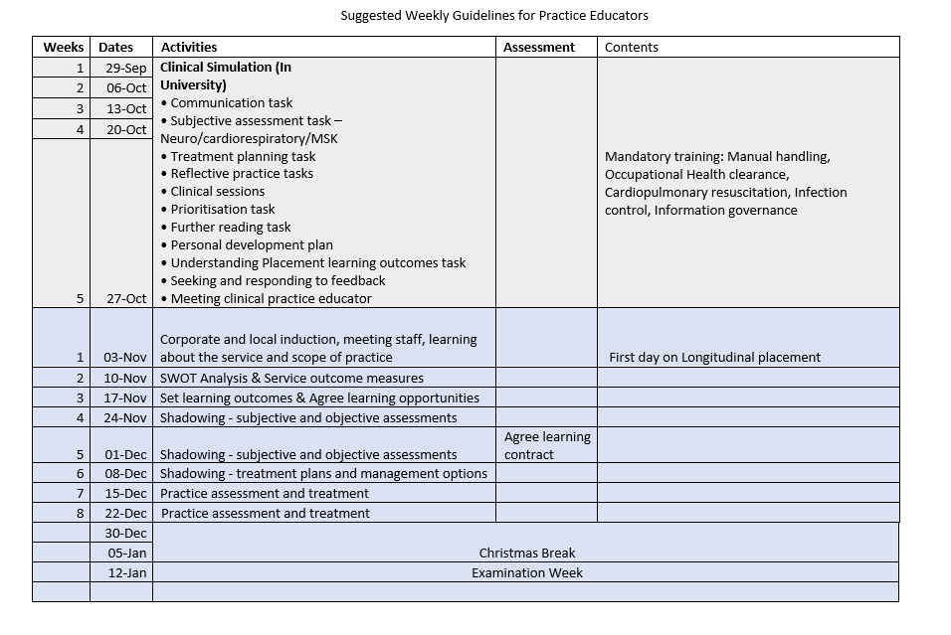

Slide 24
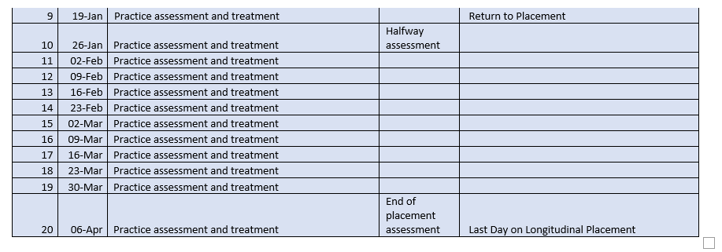

Slide 25
PT4W50
10 Weeks of Clinical Simulation
10 Weeks of Practice Placement
  5 Weeks observation
  5 Weeks gradual hands-on
  Work with Practice Educator
Weekly debriefs a day before placement

Slide 26
Requirement to attend practice education
100% attendance of clinical simulation
Completion of all mandatory training
Evidence of Occupation health clearance
Evidence of DBS clearance
Evidence of mandatory vaccination
Signed Allocations policy and DBS questionnaire (where applicable)

Slide 27

Dress code
Clinical Uniform
Each Student will be given two sets of uniform
Tunic and Polo Shirt
Two Trousers
You will shortly be contacted to submit your order for your uniforms.
A badge

Slide 28
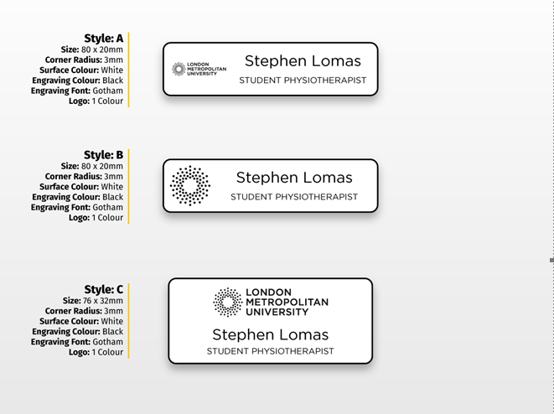
Vote on badges

Slide 29
Placement 2 for MSc Students
 | Type | When | Content | Level | Duration | Total Hours
Placement 2 | Block | Daily (Monday to Friday) 37.5 hours weekly (22/07/2024 to 30/08/2024) | Clinical practice | 5 | 6 weeks | 225hours
 | Total |  |  |  | 6 weeks | 225hours

Slide 30
Expectations
Attend
Attend placement promptly and punctually

Slide 31
Expectations
Attend
Attend placement promptly and punctually
Engage
Engage and work within the scope of your knowledge

Slide 32
Expectations
Attend
Attend placement promptly and punctually
Engage
Engage and work within the scope of your knowledge
Be professional, safe and be an ambassador for the University
Professional

Slide 33
Expectations
Attend
Attend placement promptly and punctually
Engage
Engage and work within the scope of your knowledge
Professional
Be professional, safe and be an ambassador for the University
Provide
Provide feedback to Practice Educator and the University

Slide 34
Expectations
Attend
Attend placement promptly and punctually
Engage
Engage and work within the scope of your knowledge
Professional
Be professional, safe and be an ambassador for the University
Provide
Provide feedback to Practice Educator and the University
Reflect
Reflect on your practice,

Slide 35
Overview of Assessments
 | Assessment | Mapping to Learning Outcomes | Date of submission | Pass Mark
1 | Placement Assessment 1 | LO 1, 2, 3, 4, 5 & 6 | End of placement 1 | 40% (pass all domains)
3 | Reflective CPD portfolio (500 words) | LO 6 | End of placement 1 | 40% (pass all domains)
4 | Clinical Simulation attendance | LO 1, 2, 3, 4, 5 & 6 | 24th October 2024 | 100% attendance
5 | Placement 1 attendance | LO 1, 2, 3, 4, 5 & 6 | End of placement 1 | At least 4 weeks of placement

Slide 36
Reflective CPD Portfolio
A 500-word reflective CPD portfolio on your placement experiences including a personal development plan for the next placement.

Slide 37

Module Information
Placement handbook
  Longitudinal placements
  Clinical Simulation
  Sessions
  Learning Outcomes
Weblearn
  Handouts
  Group task
  Self-directed learning
  Reading list
  Assessment

Slide 38

Questions?

Slide 39
Contact
Module Lead: Ngozi Onuegbu PhD
Email: n.onuegbu@londonmet.ac.uk
Tel: Microsoft Teams

